Slide 1
Data Analysis and Visualization Workshop for 5C Hackathon
Spring 2025

Slide 2

Introduction
Andrew Wilson Director of Research Computing, ITS

Slide 3




A bit about me

Slide 4
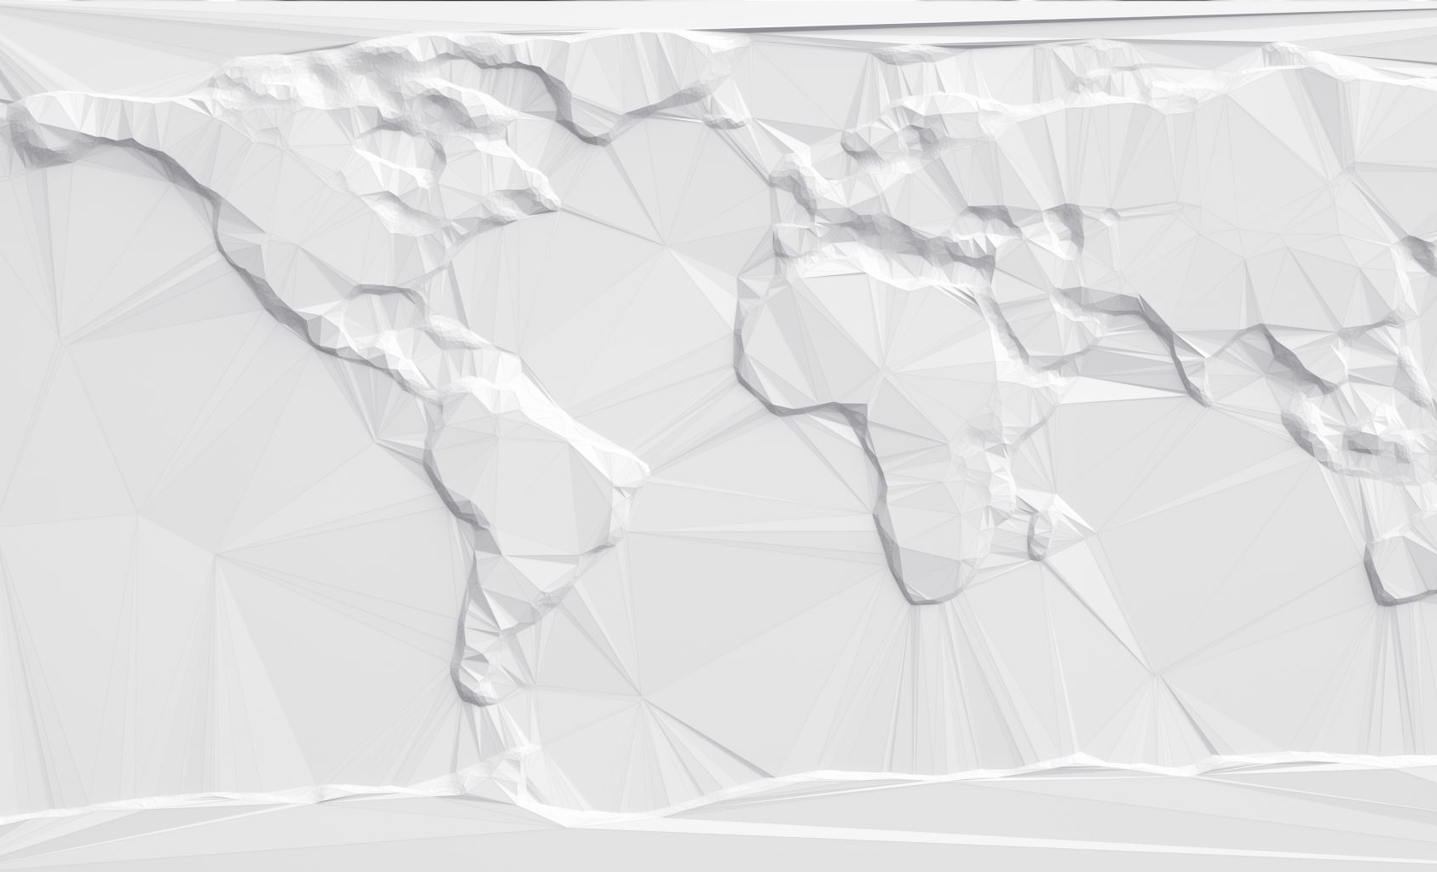
Some of my work
https://sketchfab.com/3d-models/bryn-celli-ddu-carved-stone-956a843bef19440db2333253426add44
https://awilson.sites.pomona.edu/Olynthus/DesignExplorer/

Slide 5

Workshop Overview
Learn to create effective visualizations
Balance between theory and hands-on practice
Applicable to all levels of experience
Required Packages:
pandas (data manipulation)
matplotlib (visualization)
seaborn (statistical visualization)

Slide 6
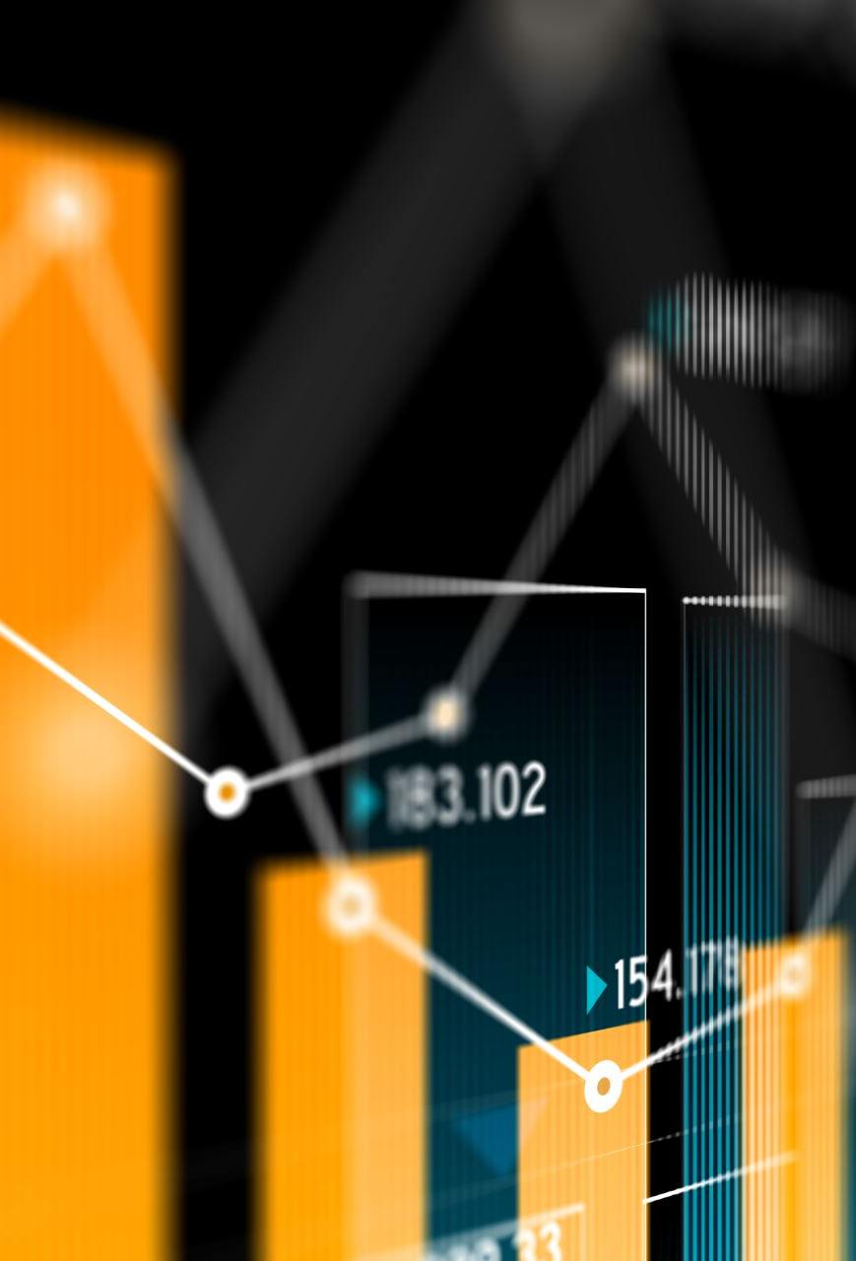
Resources
Munzner, T. (2014). Visualization Analysis and Design. CRC Press. ISBN: 978-1466508910
Comprehensive academic framework for visualization design decisions
Particularly relevant for technical hackathon projects
Wilke, C. O. (2019). Fundamentals of Data Visualization: A Primer on Making Informative and Compelling Figures. O'Reilly Media. ISBN: 978-1492031086
Practical guide with emphasis on creating clear, truthful visualizations
Perfect for hackathon teams focusing on communicating insights
VanderPlas, J. (2023). Python Data Science Handbook: Essential Tools for Working with Data (2nd Edition). O'Reilly Media. ISBN: 978-1098121228
Practical implementation using NumPy, Pandas, Matplotlib, and other Python libraries
Great resource for projects requiring data analysis

Slide 7
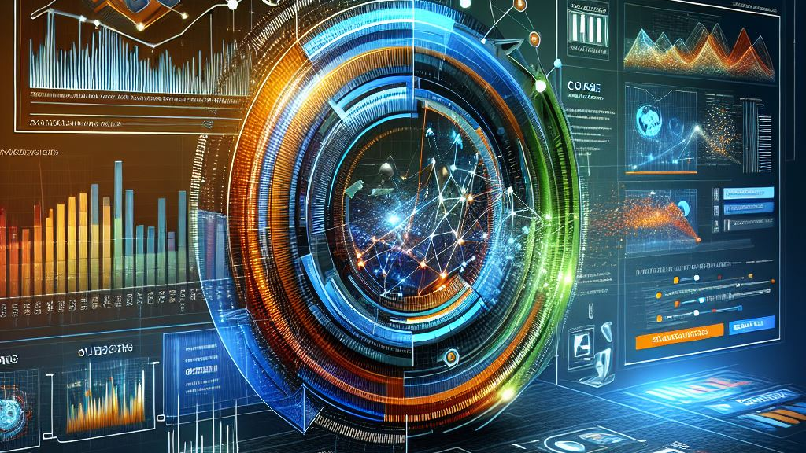

Slide 8

Why Data Visualization?
"The greatest value of a picture is when it forces us to notice what we never expected to see."
John W. Tukey Exploratory Data Analysis, 1977
Notes:
What visualizations have you found most helpful in understanding complex systems?

Slide 9
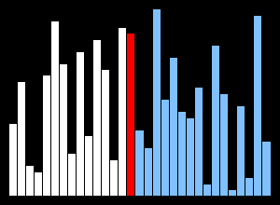
Sorting algorithms
Notes:
Sorting Algorithms

Slide 10
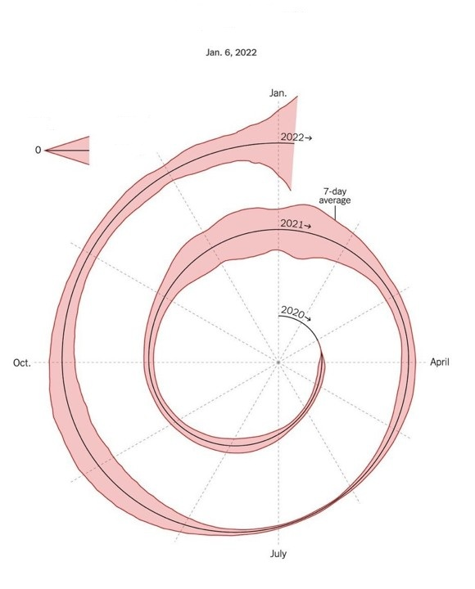
Good vs Bad Visualization
The New York Times, New Covid-19 Cases
Bad: If we can’t understand it then who can?

Slide 11
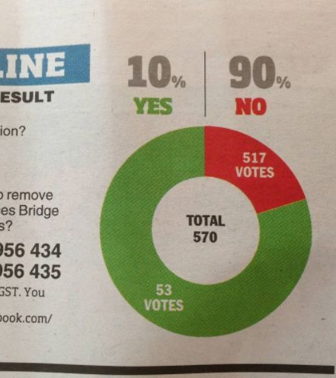
Good vs Bad Visualization
Heraldsun.com.au – Should Julia Gilliard win the next election
Bad: Yes is 10%

Slide 12
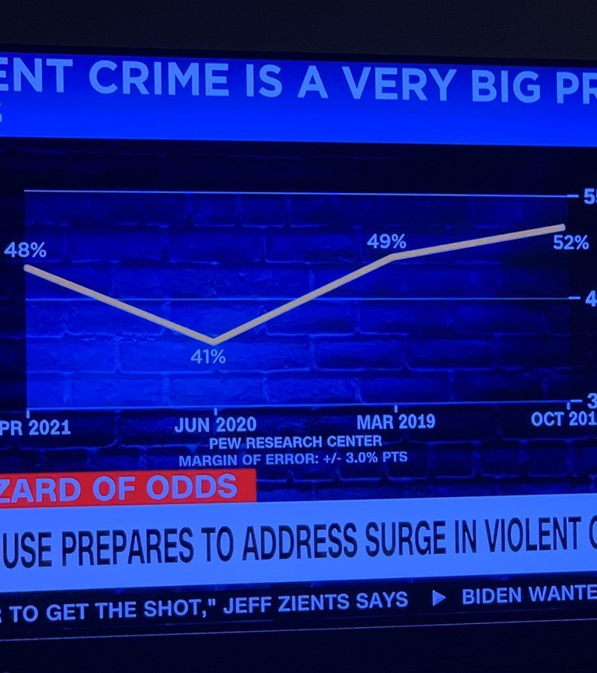
Good vs Bad Visualization
CNN – Violent Crime
Bad: Look at the X-Axis

Slide 13

Setting Up Your Development Environment
We'll use Python with specialized libraries for data visualization
Setup options:
Miniconda (recommended) - lightweight Python distribution
Full Anaconda - includes many pre-installed packages
Direct pip installation (if Python is already installed)
Why Miniconda?
Lightweight but powerful
Excellent package management
Virtual environments for project isolation
Works on Windows, macOS, and Linux

Slide 14
Installing Miniconda
Step 1: Download the installer
Visit: conda.io/miniconda.html
Select your operating system (Windows, macOS, Linux)
Choose Python 3.9+ version
Step 2: Run the installer
Windows: Double-click the downloaded .exe file
macOS: Open Terminal and run: bash Miniconda3-latest-MacOSX-x86_64.sh
Linux: Open Terminal and run: bash Miniconda3-latest-Linux-x86_64.sh
Step 3: Verify installation
Open a new terminal/command prompt
Run: conda --version
Should display the conda version number

Slide 15
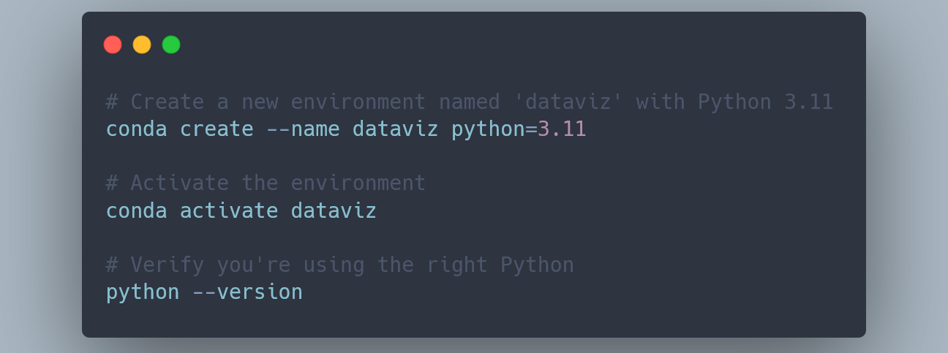
Creating a Project Environment
Why use environments?
Isolate project dependencies
Avoid conflicts between projects
Easily share environment specs with others
Reproducible setup across different computers

Slide 16
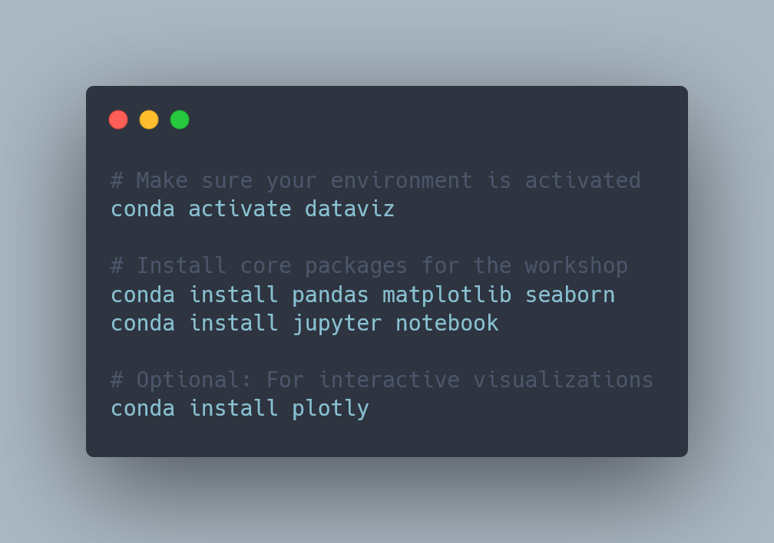
Installing Required Packages

Slide 17
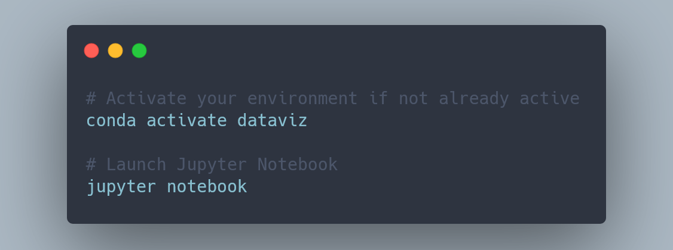
Starting Jupyter Notebook
What happens next:
Browser window should open automatically
If not, copy the URL from the terminal
Navigate to workshop folder
Create a new notebook or open existing ones

Slide 18
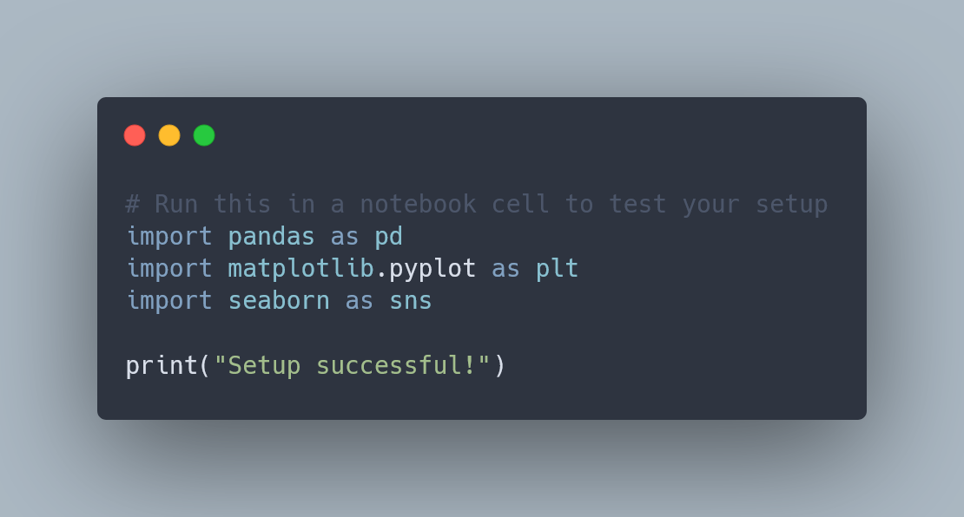
Quick Test:

Slide 19
Using VSCode for Python Development
Setup steps:
Download and install from code.visualstudio.com
Install Python extension
Select your conda environment as interpreter
View → Command Palette → "Python: Select Interpreter"
Choose the "dataviz" environment

Slide 20

Workshop Resources
Links and resources:
Workshop GitHub repository: github.com/awilson-pom/5C-dataviz-workshop
Notebooks and materials: github.com/awilson-pom/5C-dataviz-workshop/materials

Slide 21
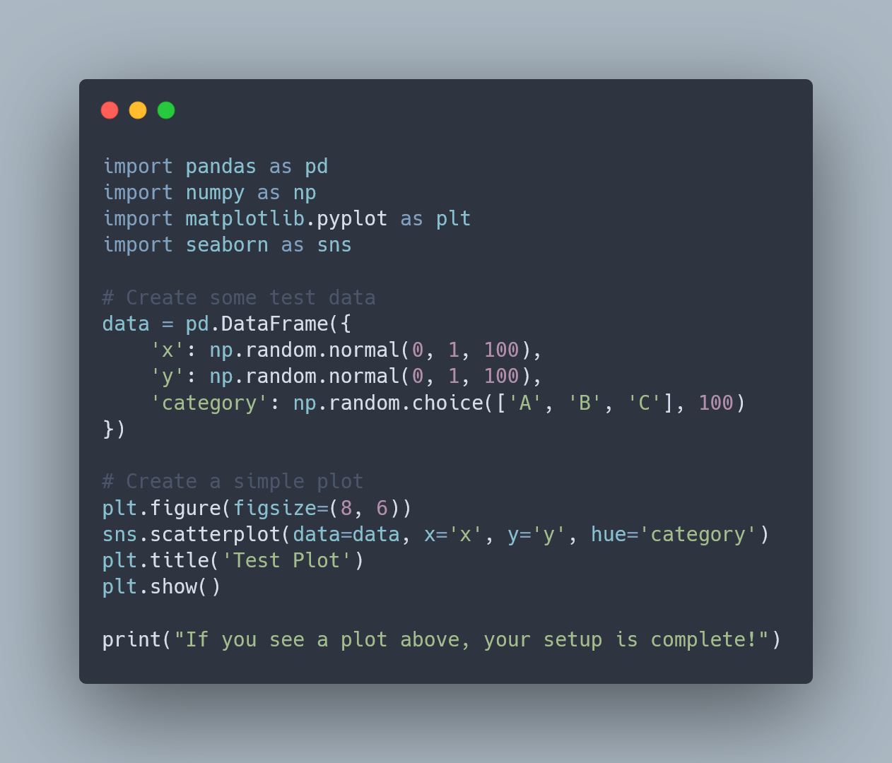
Quick Environment Test

Slide 22
The Data Analysis Workflow
Data acquisition
Clean
Explore
Rendering
Import
Communicate
Notes:
Import: Public datasets, community data, surveys
Clean: Address bias, handle missing data, ensure representation
Explore: Identify patterns, inequities, and opportunities
Model: Predict outcomes, simulate interventions
Communicate: Inspire action and change

Slide 23
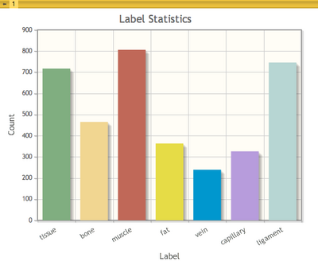
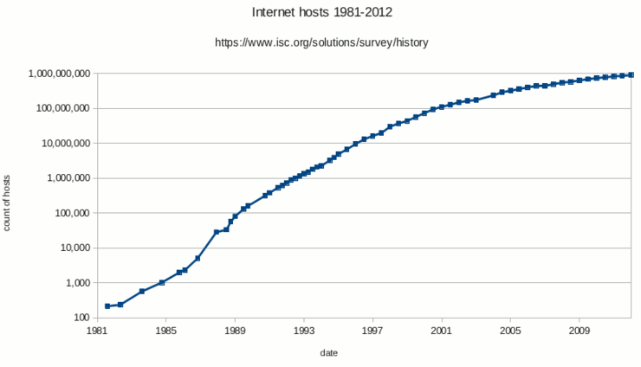
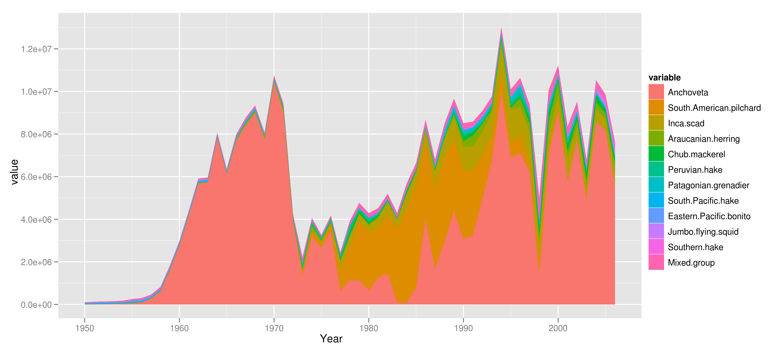
Understanding Data Types
Categorical Data:
Demographics, regions, program types
Visualize with: Bar charts, pie charts
Numerical Data:
Continuous: Temperature, income, test scores
Discrete: Counts of facilities, services
Visualize with: Histograms, line charts, scatter plots
Time Series Data:
Climate trends, educational outcomes over time
Visualize with: Line charts, area charts

Slide 24
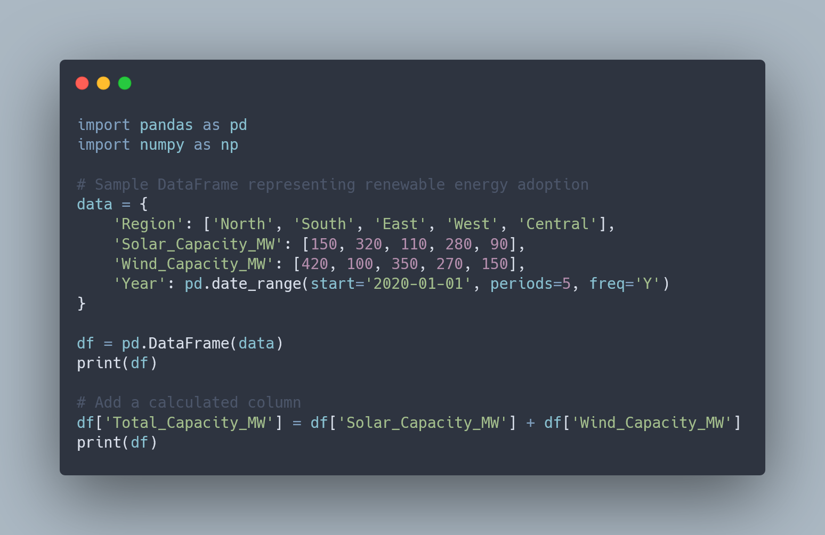
Working with Data in Python
Key Data Structures:
DataFrame: Tabular data (like a spreadsheet)
Series: Single column of data
NumPy arrays: Efficient numeric calculations
Lists and dictionaries: Python built-ins

Slide 25
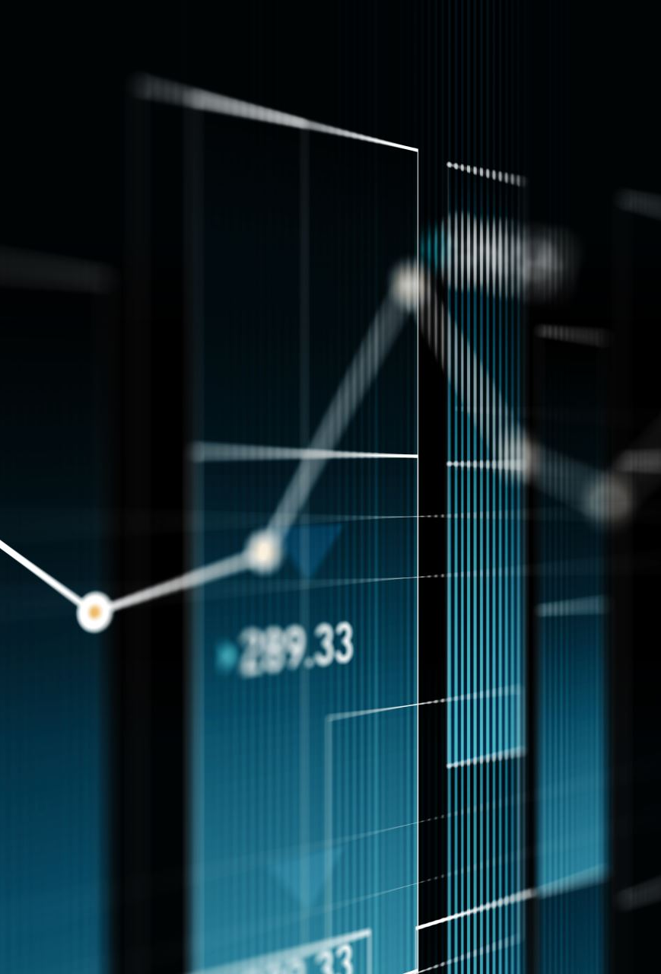
Choosing the Right Visualization
Decision Guide:
Comparing categories? → Bar charts
Showing trends over time? → Line charts
Revealing relationships? → Scatter plots
Displaying distributions? → Histograms, density plots
Showing geographic data? → Maps
Purpose-Driven Visualization:
For advocacy: Simple, emotionally resonant visuals
For analysis: Detailed, information-rich displays
For education: Clear, explanatory charts

Slide 26
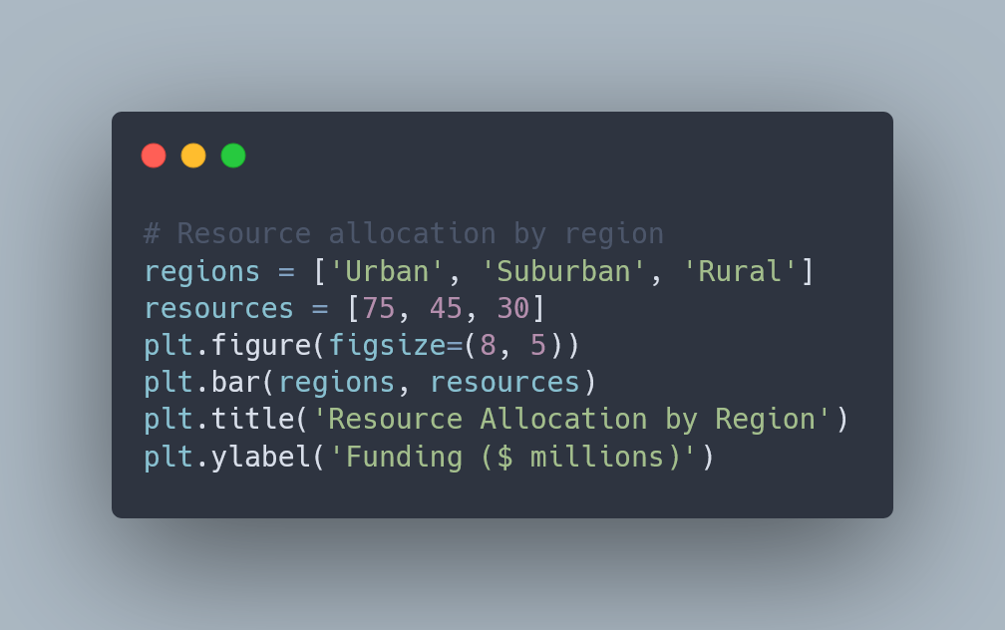
Chart Types for Storytelling
Bar Charts: Compare Categories

Slide 27
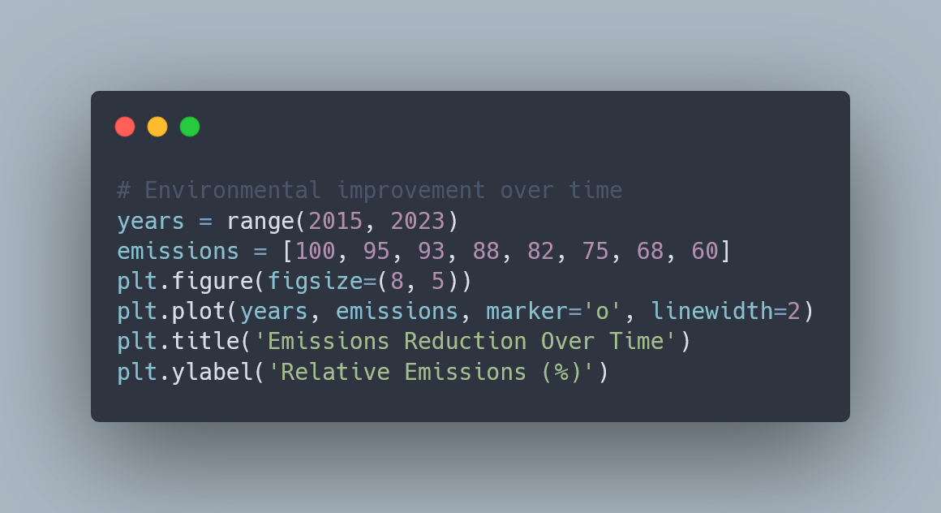
Line Charts: Show Trends

Slide 28
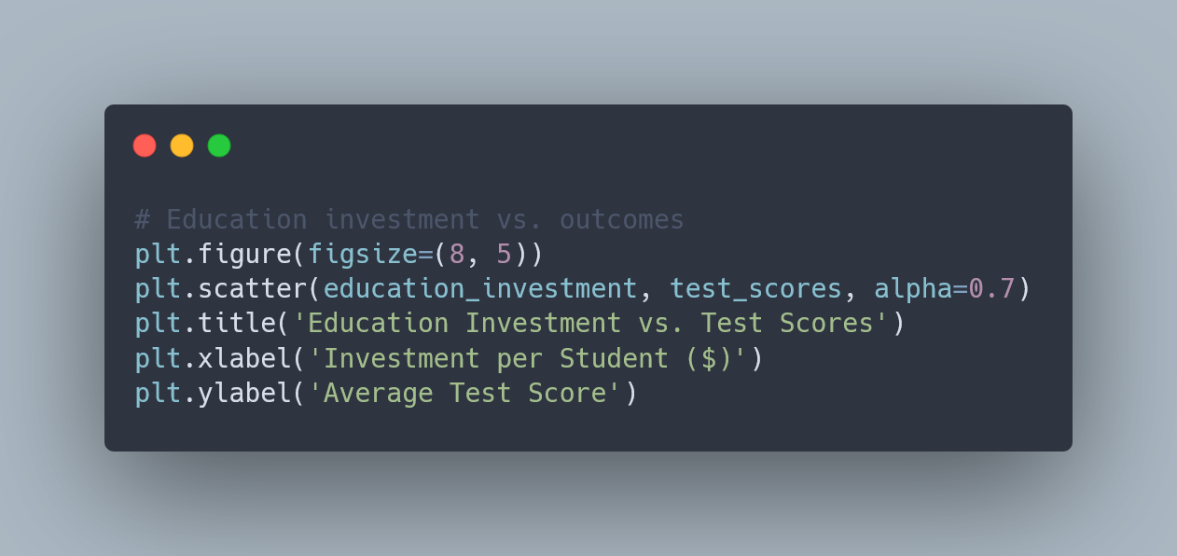
Scatter Plots: Reveal Relationships

Slide 29
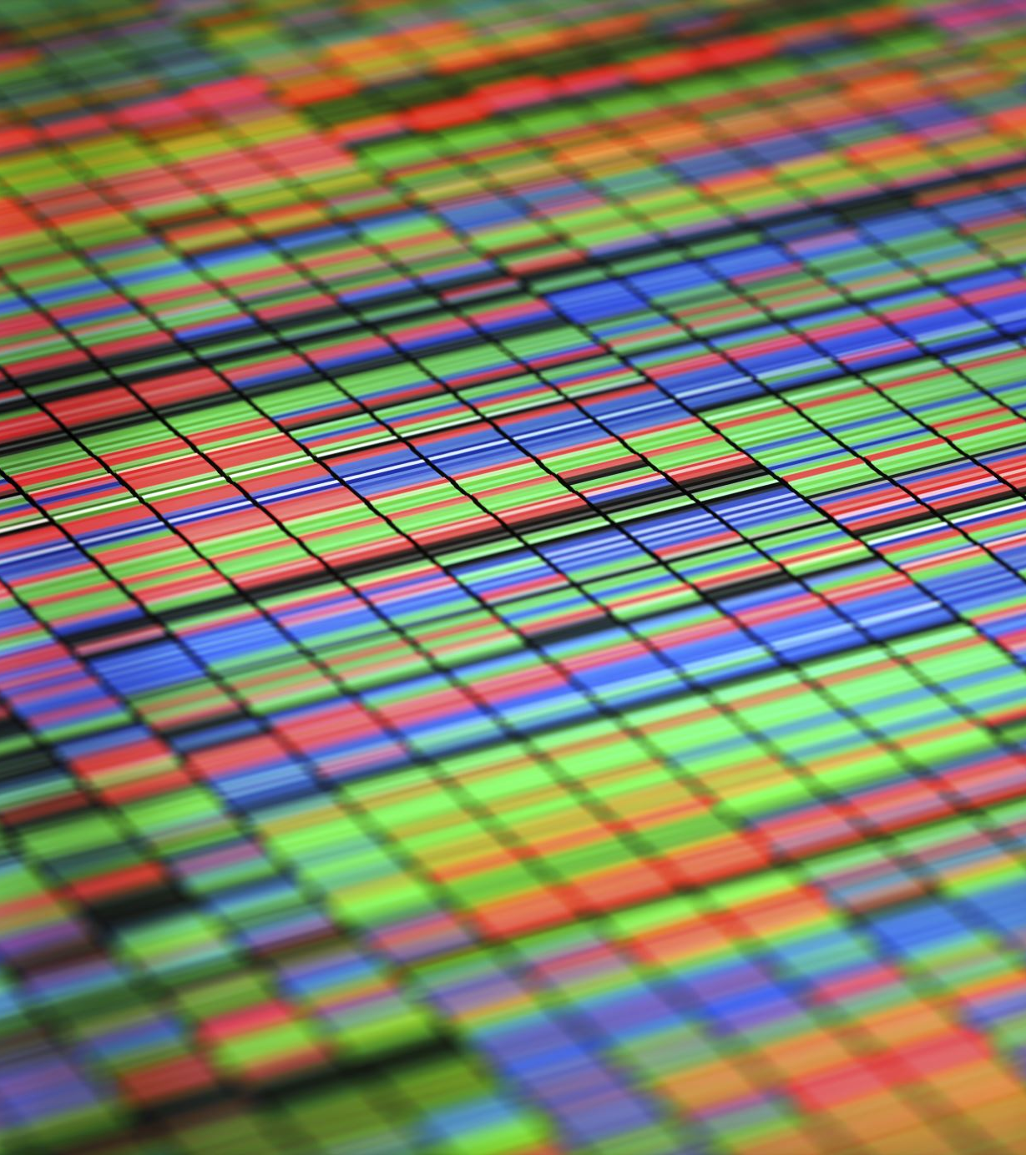
Visualization Best Practices
Best Practices:
Clear Labeling: Descriptive titles, labeled axes
Color Usage: Purposeful, not decorative
Accessibility: Colorblind-friendly palettes, sufficient contrast
Simplicity: Remove chart junk, focus on data

Slide 30
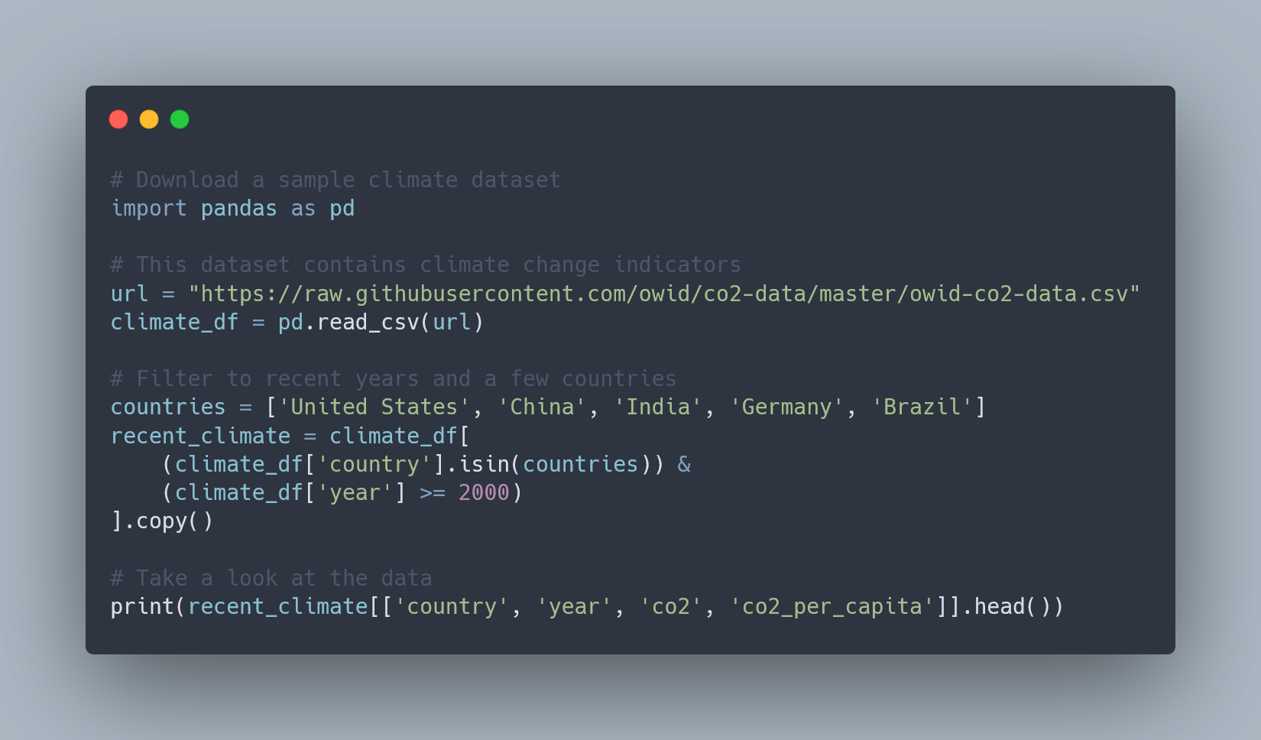
Exercise: Climate Data Visualization

Slide 31

Exercise
Create a line chart showing CO2 emissions over time by country
Create a bar chart comparing per-capita emissions for the most recent year
Create a scatter plot relating GDP per capita to emissions per capita

Slide 32
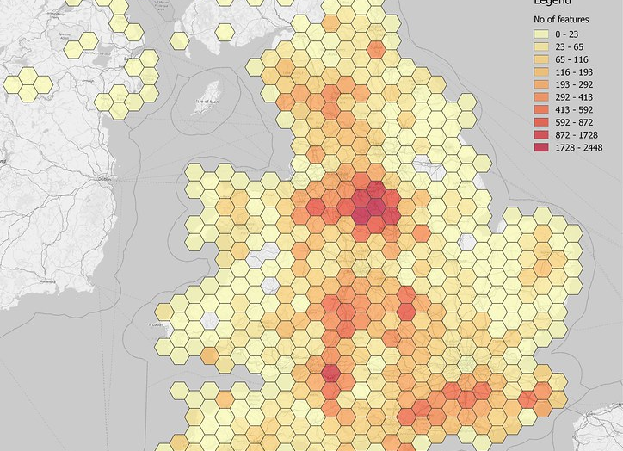
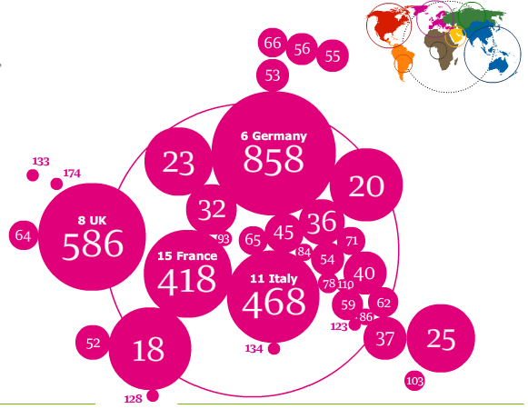
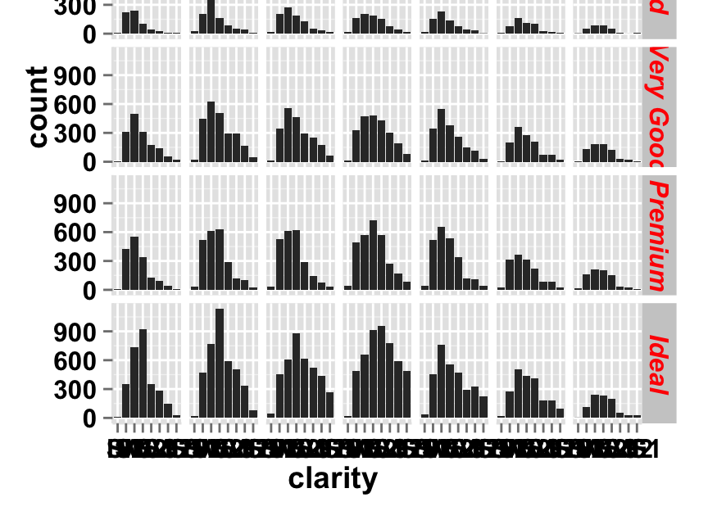
Multi-dimensional Visualizations
Heatmaps:
Purpose: Showing correlations between multiple factors
Example: Relationship between social determinants of health
Code snippet for creation
Bubble Charts:
Purpose: Displaying three dimensions at once
Example: GDP, life expectancy, and population by country
Code snippet for creation
Faceting/Small Multiples:
Purpose: Comparing patterns across groups
Example: Economic trends by demographic group
Code snippet for creation

Slide 33
Taking Visualizations to the Next Level: Interactivity
Static visualizations are powerful, but interactive ones can:
Let users explore data on their own terms
Reveal details on demand (tooltips, zooming)
Tell more complete stories with less space
Create more engaging presentations
What is Plotly?
Python library for creating beautiful interactive visualizations
Web-based: outputs work in notebooks, web apps, and dashboards
No JavaScript knowledge required
Perfect for hackathon projects with visual impact

Slide 34
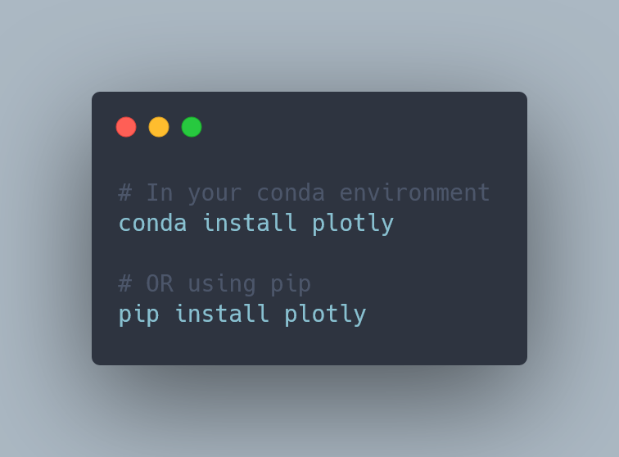
Setting Up Plotly

Slide 35
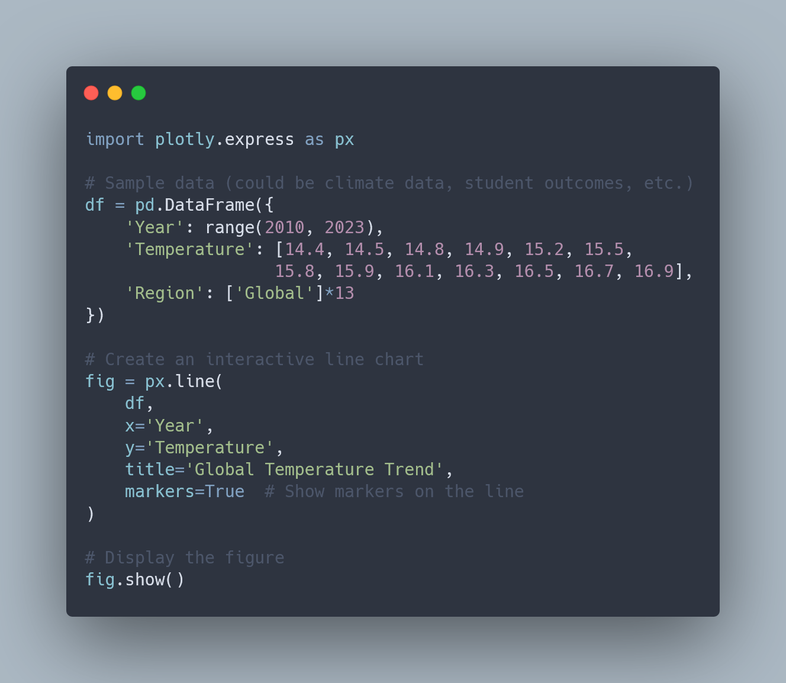
Creating Your First Interactive Plot
Key Features (Automatically Included):
Hover tooltips showing data values
Zoom and pan controls
Download as PNG button
Reset view button

Slide 36
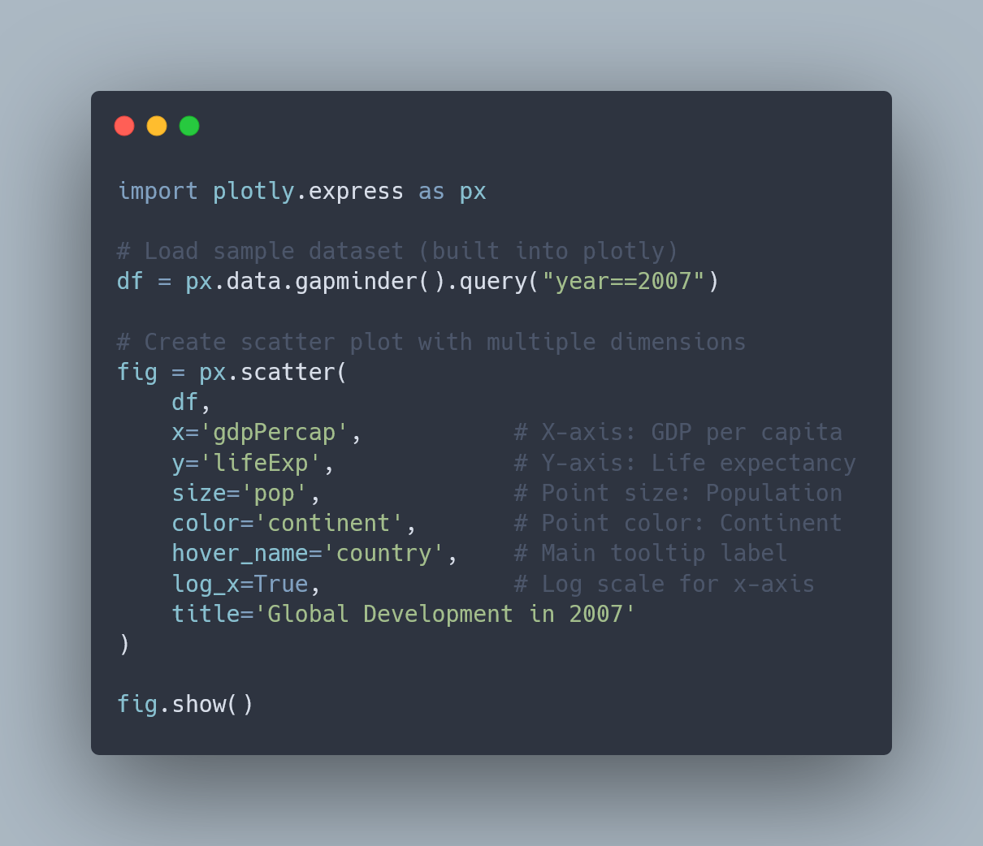
Interactive Scatter Plots

Slide 37
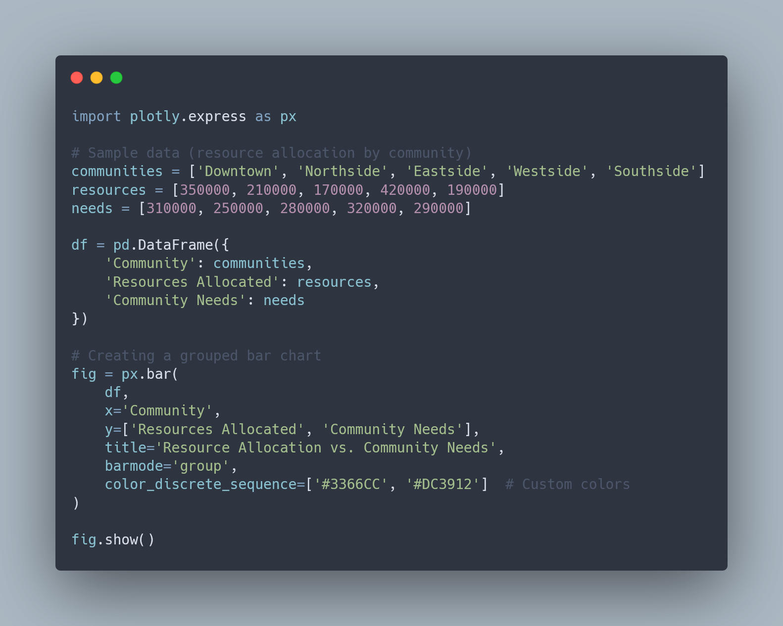
Interactive Bar Charts

Slide 38
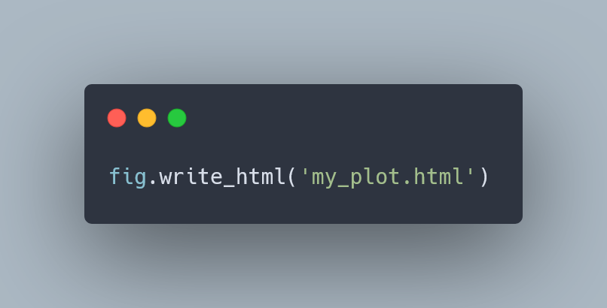
Saving and Sharing Interactive Plots

Slide 39

Data Storytelling for Impact
Narrative Structure:
Context: What's the problem?
Evidence: What's happening?
Analysis: Why is it happening?
Implications: What should we do?

Slide 40

Planning Your Visualization Strategy
Start with the Story, Not the Charts
Before writing any code, clearly define:
The key insight or message you want to convey
Who your audience is (judges, potential users, community members)
What action or response you want to inspire
Hackathon Tip: Create a 1-2 sentence "insight statement" for each visualization you plan to create. This keeps your team focused on communication rather than just technical implementation.

Slide 41

Planning Your Visualization Strategy
Scope Appropriately
For a 24-hour hackathon:
Plan for 3-5 core visualizations that tell your story
Start with the simplest version that conveys your message
Add complexity and interactivity only if time permits
Hackathon Tip: Create a visualization priority list with "must-have," "nice-to-have," and "stretch goal" items. Focus on completing the must-haves before moving to the others.

Slide 42
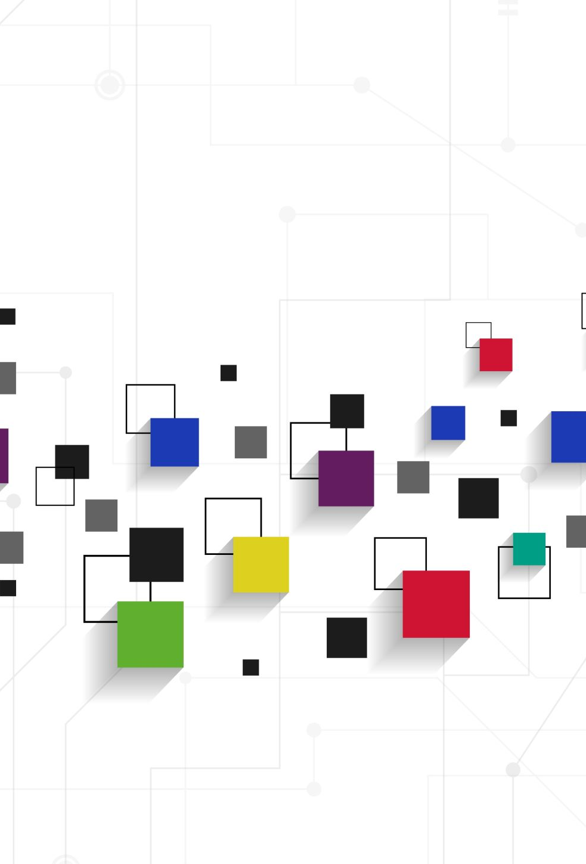
Planning Your Visualization Strategy
Choose the Right Tools for Quick Implementation
Consider these factors when choosing visualization libraries:
Matplotlib/Seaborn: Great for static visualizations with minimal code
Plotly Express: Adds interactivity with just a few additional lines of code
Streamlit: Allows rapid creation of web apps with Python
Tableau/PowerBI: If team members are already proficient, these can create polished visualizations quickly
Hackathon Tip: Stick with tools that at least one team member knows well. A hackathon is not the time to learn an entirely new framework from scratch.

Slide 43
Ethics and Responsibility
1. Represent Data Accurately
Use appropriate scales (start y-axis at zero for bar charts)
Show uncertainty where it exists
Don't cherry-pick data to support a predetermined narrative
2. Consider Accessibility
Use colorblind-friendly palettes
Include text alternatives or descriptions
Ensure sufficient contrast for readability
3. Acknowledge Limitations
Be transparent about:
Data quality issues or gaps
Assumptions made in your analysis
Potential biases in the data or interpretation

Slide 44

Good luck with your 5C Hackathon project!

Slide 45

Q&A

Slide 46

Bonus Lab
AR in (nearly) 10 lines of code

Slide 47
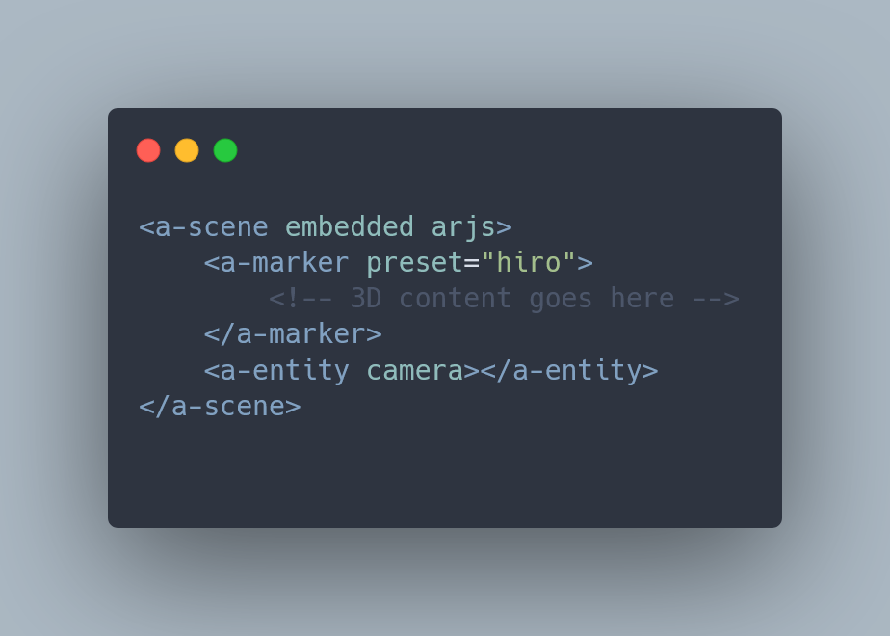
Basic AR Scene Structure

Slide 48
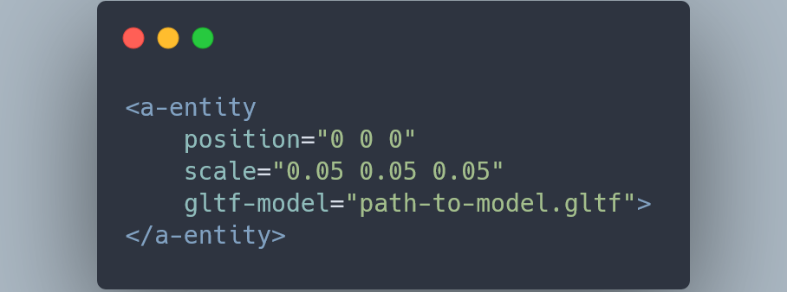
Loading 3D Models
Use GLTF format for 3D models
Position and scale models relative to marker
Models appear when marker is detected

Slide 49
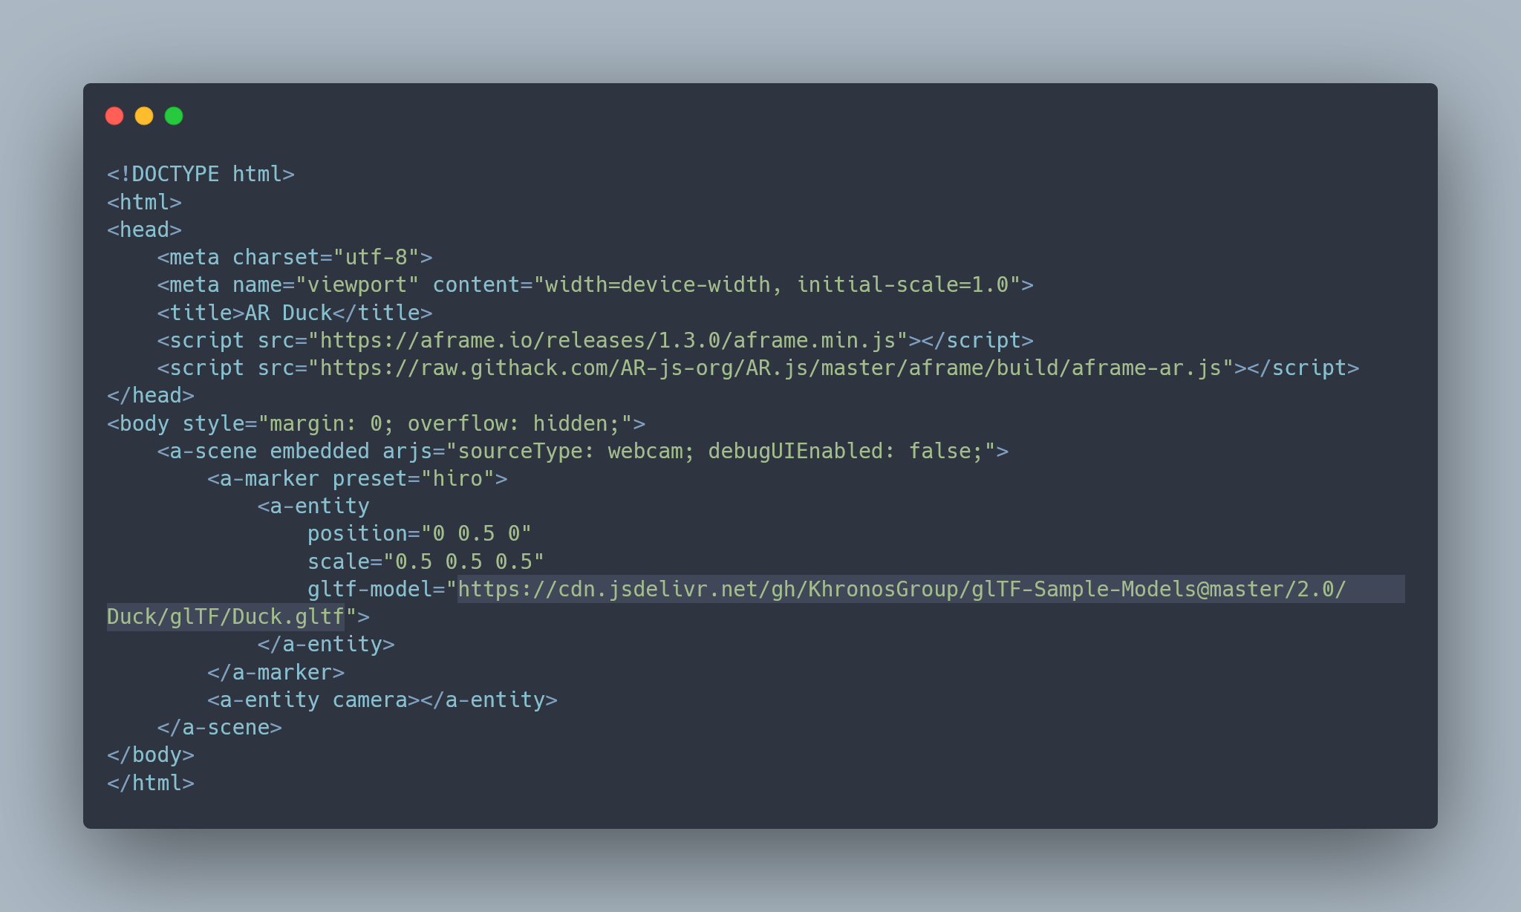
Full code

